Slide 1
Introduction to Bioinformatics LECTURE 1: The first look at a genome (sequence statistics)
1.4 Annotating a genome: statistical sequence analysis
Base composition & sliding window plot
GC content & change point analysis
Finding unusual DNA words
Biological relevance of unusual motifs
Pattern matching versus pattern discovery

Slide 2
Introduction to Bioinformatics LECTURE 1: The first look at a genome (sequence statistics)
1.4 Annotating a genome: statistical sequence analysis
Base composition H. influenzae
BASE AMOUNT FREQUENCY
A 567623 0.3102 C 350723 0.1916 G 347436 0.1898 T 564241 0.3083

Slide 3
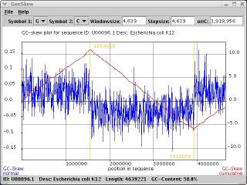
Introduction to Bioinformatics LECTURE 1: The first look at a genome (sequence statistics)
1.4 Annotating a genome: statistical sequence analysis
Base composition & sliding window plot

Slide 4
GC content
GC versus AT
Organism GC content
H. influenzae 38.8
M. tuberculosis 65.8
S. enteridis 49.5

Slide 5
GC content
Detect foreign genetic material
Horizontal gene transfer
Change point analysis
AT denatures (=splits) at lower temperatures
Thermophylic Archaeabacteriae: high CG
Evolution: Archaea > Eubacteriae > Eukaryotes

Slide 6
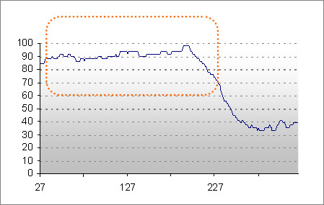
GC content
Example of very high GC content
Average GC content: 61%

Slide 7
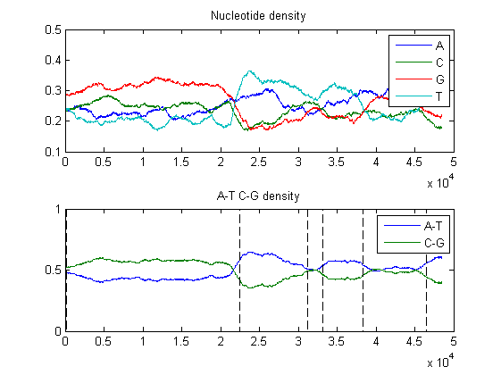
Change points in Labda-phage

Slide 8
Unusual DNA-words
Restriction sites: very unusual words
CTAG -> “knicking” of DNA-strand

Slide 9
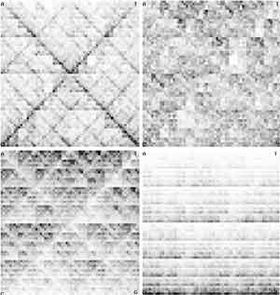
genome signature:
Nucleotide motif bias in four genomes

Slide 10
Introduction to Bioinformatics LECTURE 1: The first look at a genome (sequence statistics)
1.5 Finding data: GenBank, EMBL, and DDBJ
Online databases
FASTA: a standard data format

Slide 11
DATABASES
Generalized (DNA, proteins and carbohydrates, 3D-structures)
Specialized (EST, STS, SNP, RNA, genomes, protein families, pathways, microarray data ...)

Slide 12
OVERVIEW OF DATABASES
Database indexing and specification of search terms (retrieval, follow-up, analysis)
Archives (databases on: nucleic acid sequences, genome, protein sequences, structures, proteomics, expression, pathways)
Gateways to Archives (NCBI, Entrez, PubMed, ExPasy, Swiss-Prot, SRS, PIR, Ensembl)

Slide 13
Generalized DNA, protein
and carbohydrate databases
Primary sequence databases
EMBL (European Molecular Biology Laboratory nucleotide sequence database at EBI, Hinxton, UK) GenBank (at National Center for Biotechnology information, NCBI, Bethesda, MD, USA) DDBJ (DNA Data Bank Japan at CIB , Mishima, Japan)
Calculate the MD5 sum checks: Summary statistics checksums values????
For Mac users use this on terminal: md5 filename
For Windows user use this on terminal: md5sum filename
Example fo sum check value: MD5 (Genemab-Pawar-Presentation.pptx) = ead287b2b2e7ae8985ee0f3ac5b71950

Slide 14

NCBI: National Center for
Biotechnology information
Established in 1988 as a national resource for molecular biology information, NCBI creates public databases, conducts research in computational biology, develops software tools for analyzing genome data, and disseminates biomedical information - all for the better understanding of molecular processes affecting human health and disease.

Slide 15
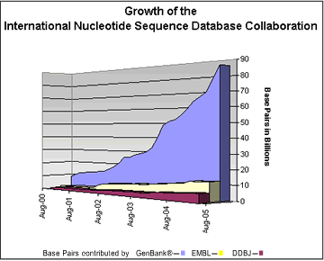
NCBI - GenBank

Slide 16

The EMBL Nucleotide Sequence Database (also known as EMBL-Bank) constitutes Europe's primary nucleotide sequence resource. Main sources for DNA and RNA sequences are direct submissions from individual researchers, genome sequencing projects and patent applications.

Slide 17

EBI: European
Bioinformatics Institute
The European Bioinformatics Institute (EBI) is a non-profit academic organisation that forms part of the European Molecular Biology Laboratory (EMBL). The EBI is a centre for research and services in bioinformatics. The Institute manages databases of biological data including nucleic acid, protein sequences and macromolecular structures.
Our mission
To provide freely available data and bioinformatics services to all facets of the scientific community in ways that promote scientific progress
To contribute to the advancement of biology through basic investigator-driven research in bioinformatics Example: Galaxy!! (https://usegalaxy.org/) EXPLAIN, REGISTER AND EXPLORE!!
To provide advanced bioinformatics training to scientists at all levels, from PhD students to independent investigators
To help disseminate cutting-edge technologies to industry

Slide 18

What is DDBJ
DDBJ (DNA Data Bank of Japan) began DNA data bank activities in earnest in 1986 at the National Institute of Genetics (NIG). DDBJ has been functioning as the international nucleotide sequence database in collaboration with EBI/EMBL and NCBI/GenBank. DNA sequence records the organismic evolution more directly than other biological materials and ,thus, is invaluable not only for research in life sciences, but also human welfare in general. The databases are, so to speak, a common treasure of human beings. With this in mind, we make the databases online accessible to anyone in the world

Slide 19

ExPASy Proteomics Server
(SWISS-PROT)
The ExPASy (Expert Protein Analysis System) proteomics server of the Swiss Institute of Bioinformatics (SIB) is dedicated to the analysis of protein sequences and structures as well as 2-D PAGE

Slide 20
Generalized DNA, protein
and carbohydrate databases EXAM2
Protein sequence databases
SWISS-PROT (Swiss Institute of Bioinformatics, SIB, Geneva, CH)
TrEMBL (=Translated EMBL: computer annotated protein sequence database at EBI, UK)
PIR-PSD (PIR-International Protein Sequence Database, annotated protein database by PIR, MIPS and JIPID at NBRF, Georgetown University, USA)
UniProt (Joined data from Swiss-Prot, TrEMBL and PIR)
UniRef (UniProt NREF (Non-redundant REFerence) database at EBI, UK)
IPI (International Protein Index; human, rat and mouse proteome database at EBI, UK)

Slide 21
Generalized DNA, protein
and carbohydrate databases
Carbohydrate databases
CarbBank (Former complex carbohydrate structure database, CCSD, discontinued!)
3D structure databases
PDB (Protein Data Bank cured by RCSB, USA) EBI-MSD (Macromolecular Structure Database at EBI, UK )
NDB (Nucleic Acid structure Datatabase at Rutgers State University of New Jersey , USA)

Slide 22
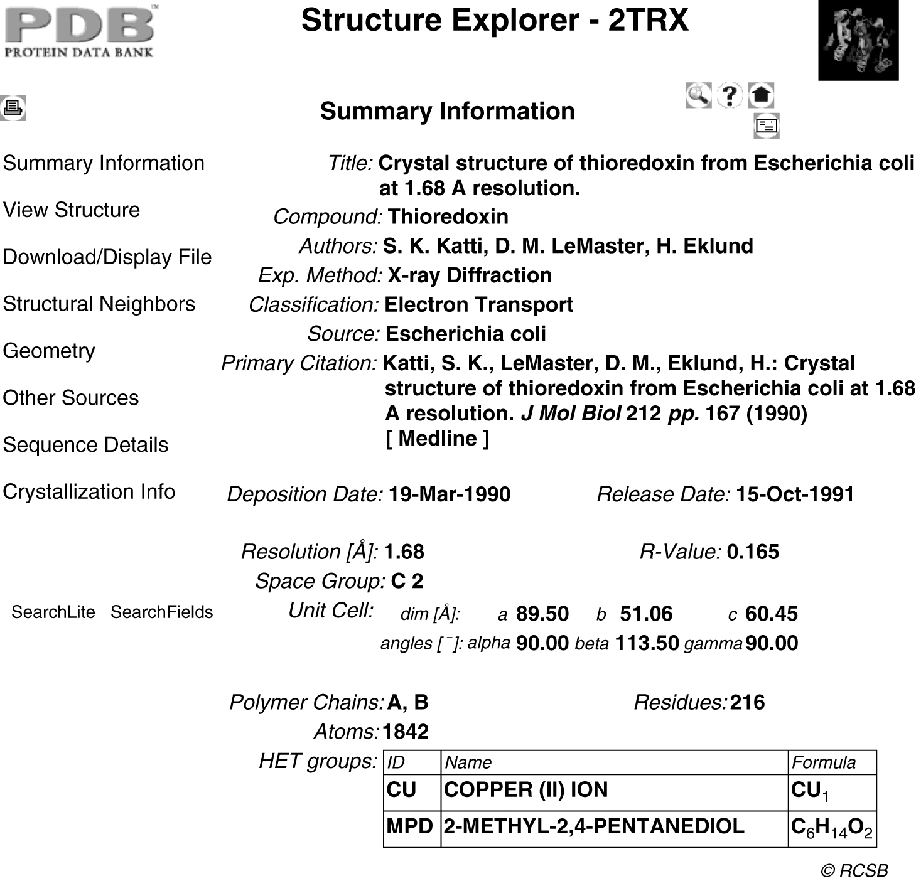
PROTEIN DATA BANK

Slide 23
DATABASE SEARCH
Text-based (SRS, Entrez ...)
Sequence-based (sequence similarity search) (BLAST, FASTA...)
Motif-based (ScanProsite, eMOTIF)
Structure-based (structure similarity search) (VAST, DALI...)
Mass-based protein search (ProteinProspector, PeptIdent, Prowl …)

Slide 24


Search across databases Help
Welcome to the Entrez cross-database search page
PubMed: biomedical literature citations and abstracts PubMed Central: free, full text journal articles Site Search: NCBI web and FTP sites Books: online books OMIM: online Mendelian Inheritance in Man OMIA: online Mendelian Inheritance in Animals Nucleotide: sequence database (GenBank) Protein: sequence database Genome: whole genome sequences Structure: three-dimensional macromolecular structures Taxonomy: organisms in GenBank SNP: single nucleotide polymorphism Gene: gene-centered information HomoloGene: eukaryotic homology groups PubChem Compound: unique small molecule chemical structures PubChem Substance: deposited chemical substance records Genome Project: genome project information UniGene: gene-oriented clusters of transcript sequences CDD: conserved protein domain database 3D Domains: domains from Entrez Structure UniSTS: markers and mapping data PopSet: population study data sets GEO Profiles: expression and molecular abundance profiles GEO DataSets: experimental sets of GEO data Cancer Chromosomes: cytogenetic databases PubChem BioAssay: bioactivity screens of chemical substances GENSAT: gene expression atlas of mouse central nervous system Probe: sequence-specific reagents

Slide 25
New! Assembly Archive recently created at NCBI links together trace data and finished sequence providing complete information about a genome assembly. The Assembly Archive's first entries are a set of closely related strains of Bacillus anthracis. The assemblies are avalaible at TraceAssembly See more about Bacillus anthracis genome Bacillus licheniformis ATCC 14580Release Date: September 15, 2004 Reference: Rey,M.W.,et al. Complete genome sequence of the industrial bacterium Bacillus licheniformis and comparisons with closely related Bacillus species (er) Genome Biol. 5, R77 (2004) Lineage: Bacteria; Firmicutes; Bacillales; Bacillaceae; Bacillus. Organism: Bacillus licheniformis ATCC 14580 Genome sequence information chromosome - CP000002 - NC_006270 Size: 4,222,336 bp Proteins: 4161 Sequence data files submitted to GenBank/EMBL/DDBJ can be found at NCBI FTP: GenBank or RefSeq Genomes Bacillus cereus ZKRelease Date: September 15, 2004 Reference: Brettin,T.S., et al. Complete genome sequence of Bacillus cereus ZK Lineage: Bacteria; Firmicutes; Bacillales; Bacillaceae; Bacillus; Bacillus cereus group. Organism:

Slide 26
BLAST
NCBI → BLAST Latest news: 6 December 2005 : BLAST 2.2.13 released About
Getting started / News / FAQs
More info
NAR 2004 / NCBI Handbook / The Statistics of Sequence Similarity Scores
Software
Downloads / Developer info
Other resources
References / NCBI Contributors / Mailing list / Contact us
The Basic Local Alignment Search Tool (BLAST) finds regions of local similarity between sequences. The program compares nucleotide or protein sequences to sequence databases and calculates the statistical significance of matches. BLAST can be used to infer functional and evolutionary relationships between sequences as well as help identify members of gene families. Nucleotide
Quickly search for highly similar sequences (megablast)
Quickly search for divergent sequences (discontiguous megablast)
Nucleotide-nucleotide BLAST (blastn)
Search for short, nearly exact matches
Search trace archives with megablast or discontiguous megablast
Protein
Protein-protein BLAST (blastp)
Position-specific iterated and pattern-hit initiated BLAST (PSI- and PHI-BLAST)
Search for short, nearly exact matches
Search the conserved domain database (rpsblast)
Protein homology by domain architecture (cdart)
Translated
Translated query vs. protein database (blastx)
Protein query vs. translated database (tblastn)
Translated query vs. translated database (tblastx)
Genomes
Human, mouse, rat, chimp , cow, pig, dog, sheep, cat
Chicken, puffer fish, zebrafish
Environmental samples
Protozoa
Insects, nematodes, plants, fungi, microbial genomes, other eukaryotic genomes
Special
Search for gene expression data (GEO BLAST)
Align two sequences (bl2seq)
Screen for vector contamination (VecScreen)
Immunoglobin BLAST (IgBlast)
SNP BLAST
Meta
Retrieve results
Disclaimer Privacy statement Accessibility This page is valid XHTML 1.0.

Slide 27
Fasta Protein Database Query
Provides sequence similarity searching against nucleotide and protein databases using the Fasta programs.
Fasta can be very specific when identifying long regions of low similarity especially for highly diverged sequences.
You can also conduct sequence similarity searching against complete proteome or genome databases using the Fasta programs.

Slide 28

Kangaroo
MOTIV BASED SEARCH
Kangaroo is a program that facilitates searching for gene and protein patterns and sequences
Kangaroo is a pattern search program. Given a sequence pattern the program will find all the records that contain that pattern. To use this program, simply enter a sequence of DNA or Amino Acids in the pattern window, choose the type of search, the taxonomy and submit your request.

Slide 29
ANALYSIS TOOLS
DNA sequence analysis tools
RNA analysis tools
Protein sequence and structure analysis tools (primary, secondary, tertiary structure)
Tools for protein Function assignment
Phylogeny
Microarray analysis tools

Slide 30
Pairwise alignment: DNA sequences can be more informative than protein
Many times, DNA alignments are appropriate --to study noncoding regions of DNA (e.g. introns or intergenic regions) --to study DNA polymorphisms --genome sequencing relies on DNA analysis
Pairwise alignment The process of lining up two sequences to achieve maximal levels of identity (and conservation, in the case of amino acid sequences) for the purpose of assessing the degree of similarity and the possibility of homology.

Slide 31
Identity The extent to which two (nucleotide or amino acid) sequences are invariant.
Similarity The extent to which nucleotide or protein sequences are related. It is based upon identity plus conservation.
Conservation Changes at a specific position of an amino acid or (less commonly, DNA) sequence that preserve the physicochemical properties of the original residue.
Homology Similarity attributed to descent from a common ancestor

Slide 32
Definitions: two types of homology
Orthologs Homologous sequences in different species that arose from a common ancestral gene during speciation; may or may not be responsible for a similar function.
Paralogs Homologous sequences within a single species that arose by gene duplication.

Slide 33
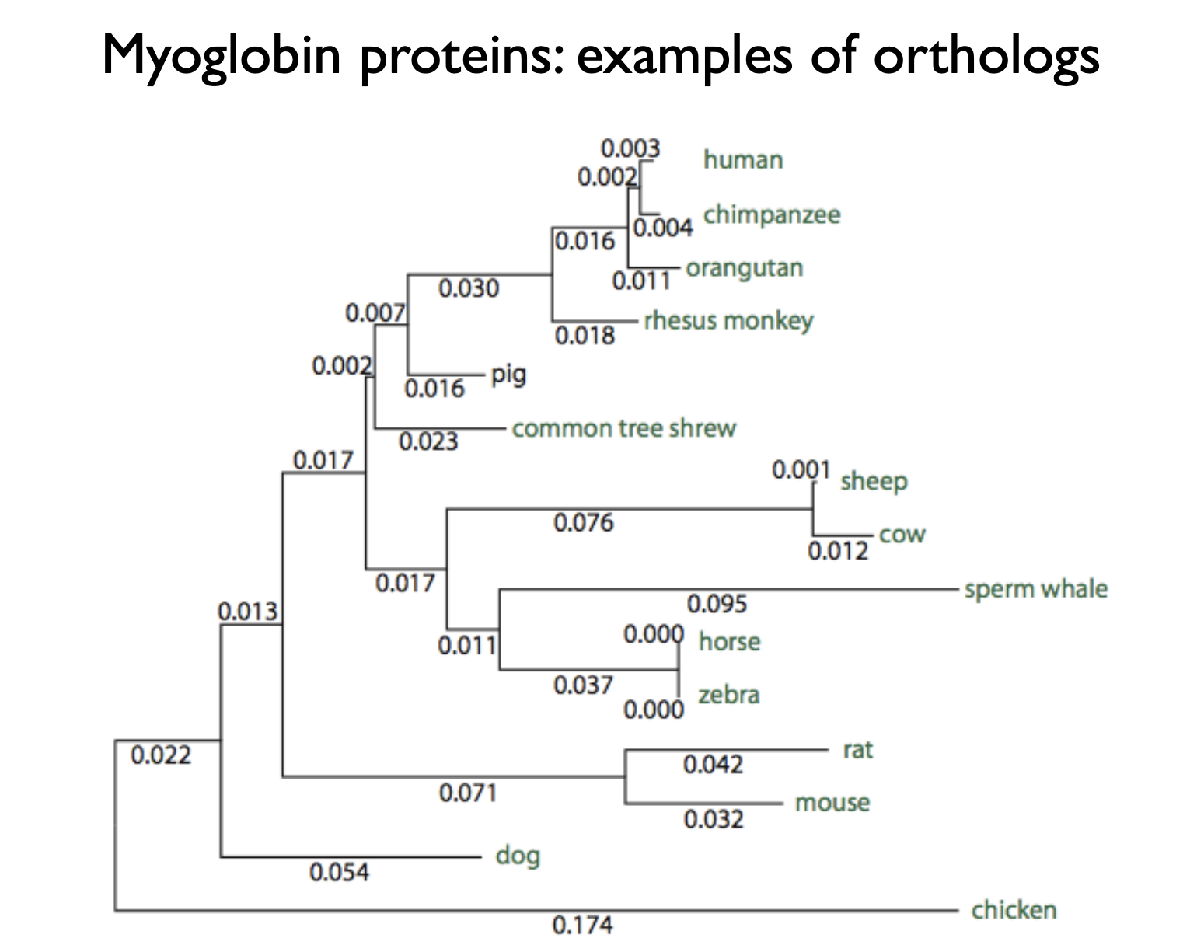

Slide 34
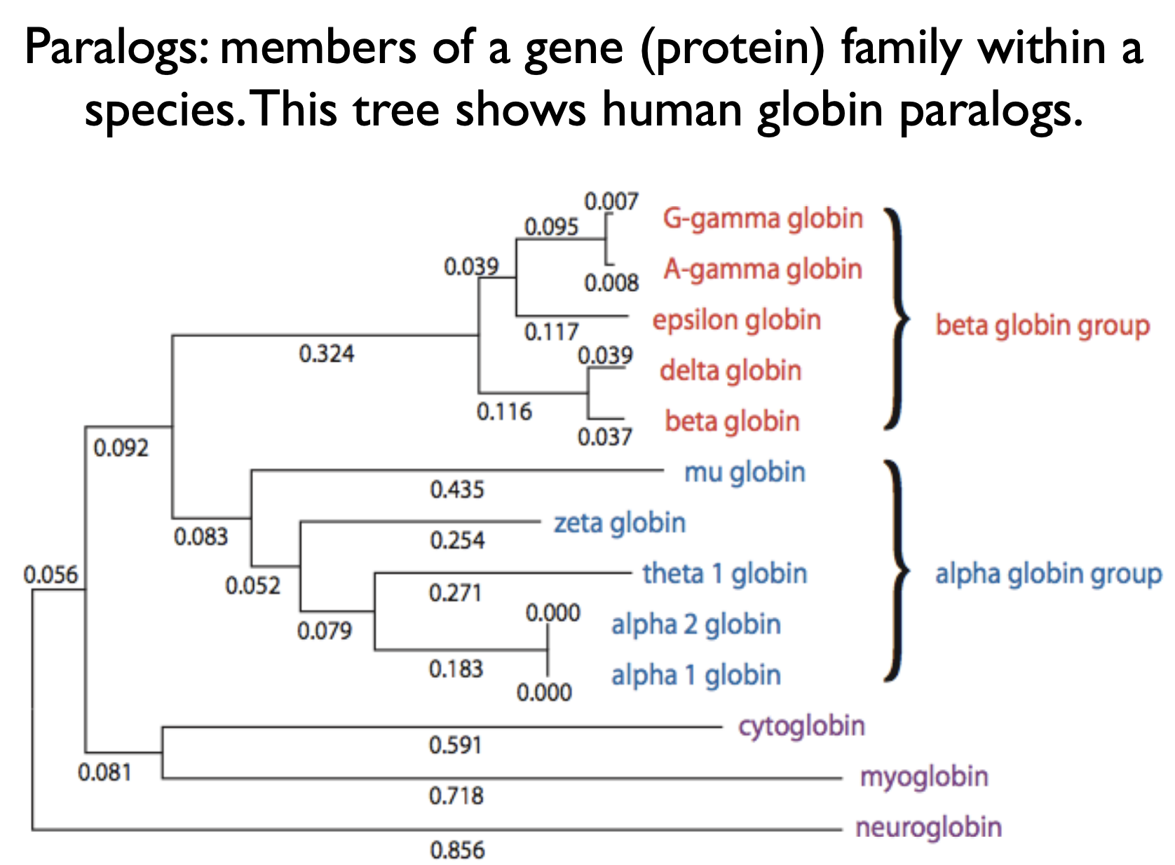

Slide 35
General approach to pairwise alignment
Choose two sequences • Select an algorithm that generates a score • Allow gaps (insertions, deletions) • Score reflects degree of similarity • Alignments can be global or local • Estimate probability that the alignment occurred by chance

Slide 36
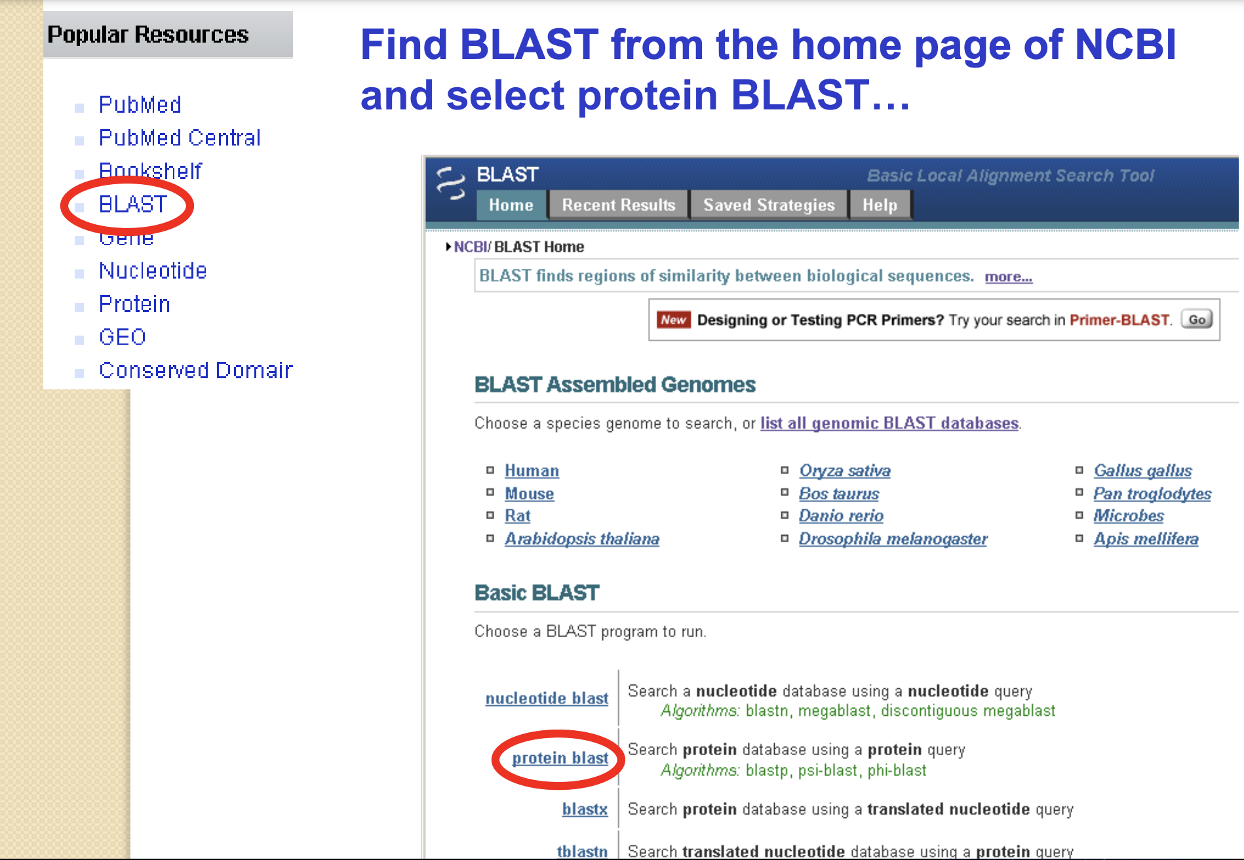
Exercise

Slide 37
Gaps
Positions at which a letter is paired with a null are called gaps. • Gap scores are typically negative. • Since a single mutational event may cause the insertion or deletion of more than one residue, the presence of a gap is ascribed more significance than the length of the gap. Thus there are separate penalties for gap creation and gap extension. • In BLAST, it is rarely necessary to change gap values from the default.

Slide 38
Pairwise alignment and the evolution of life
When two proteins (or DNA sequences) are homologous they share a common ancestor. We can infer the sequence of that ancestor. When we align globins from human and a plant we can imagine their common ancestor, a single celled organism that lived 1.5 billion years ago, and we can infer that ancient globin sequence. Through pairwise alignment we can look back in time at sequence evolution.

Slide 39
Algorithm
Step 1: Accepted point mutations (PAMs) in protein families
Margaret Dayhoff and colleagues developed scoring matrices in the 1960s and 1970s. They defined PAMs as “accepted point mutations.” Some protein families evolve very slowly (e.g. histones change little over 100 million years); others (such as kappa casein) change very rapidly.

Slide 40
Step 1: accepted point mutations are defined not by the pairwise alignment but with respect to the common ancestor
Dayhoff model step 2 (of 7): Frequency of amino acids. If 20 amino acids occurred in nature at equal frequencies, each would be observed 5% of the time.
Dayhoff model step 3: amino acid substitutions. From a survey of observed substitutions, the original amino acid (columns) are compared to the changes (rows).
Dayhoff step 4 (of 7): Mutation probability matrix for the evolutionary distance of 1 PAM. This mutation probability matrix includes original amino acids (columns) and replacements (rows). The diagonals show that at a distance of 1 PAM most residues remain the same about 99% of the time (see shaded entries). Note how cysteine (C) and tryptophan (W) undergo few substitutions, and asparagine (N) many.

Slide 41
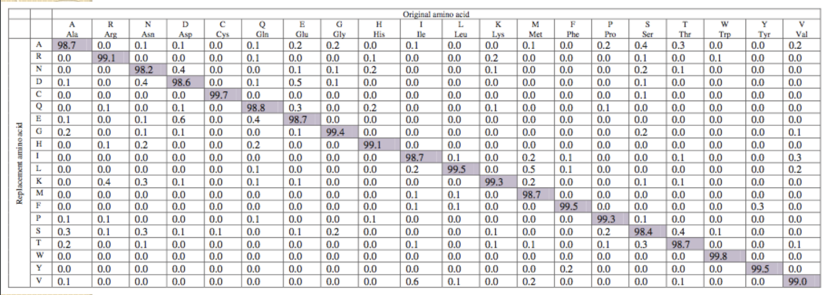
Substitution Matrix
A substitution matrix contains values proportional to the probability that amino acid i mutates into amino acid j for all pairs of amino acids. Substitution matrices are constructed by assembling a large and diverse sample of verified pairwise alignments (or multiple sequence alignments) of amino acids. Substitution matrices should reflect the true probabilities of mutations occurring through a period of evolution. The two major types of substitution matrices are PAM and BLOSUM.

Slide 42
Dayhoff step 6 (of 7): from a mutation probability matrix to a relatedness odds matrix. A relatedness odds matrix reports the probability that amino acid j will change to i in a homologous sequence.
A higher PAM number correspond to a matrix tuned to more divergent proteins.

Slide 43
Two kinds of sequence alignment: global and local
We will first consider the global alignment algorithm of Needleman and Wunsch (1970). We will then explore the local alignment algorithm of Smith and Waterman (1981). BLAST, a heuristic version of Smith-Waterman.

Slide 44
Global alignment with the algorithm of Needleman and Wunsch (1970)
Two sequences can be compared in a matrix along x- and y-axes. • If they are identical, a path along a diagonal can be drawn • Find the optimal subpaths, and add them up to achieve the best score. This involves --adding gaps when needed --allowing for conservative substitutions --choosing a scoring system (simple or complicated) • N-W is guaranteed to find optimal alignment(s)

Slide 45
Global alignment versus local alignment
Global alignment (Needleman-Wunsch) extends from one end of each sequence to the other. Local alignment finds optimally matching regions within two sequences (“subsequences”). Local alignment is almost always used for database searches such as BLAST. It is useful to find domains (or limited regions of homology) within sequences. Smith and Waterman (1981) solved the problem of performing optimal local sequence alignment. Other methods (BLAST, FASTA) are faster but less thorough.

Slide 46
Rapid, heuristic versions of Smith-Waterman: FASTA and BLAST
Smith-Waterman is very rigorous and it is guaranteed to find an optimal alignment. But Smith-Waterman is slow. It requires computer space and time proportional to the product of the two sequences being aligned (or the product of a query against an entire database). Gotoh (1982) and Myers and Miller (1988) improved the algorithms so both global and local alignment require less time and space. FASTA and BLAST provide rapid alternatives to S-W.

